Slide 1







E-Commerce Product Reviews
Daniel S. Ohara

Slide 2
Project Proposal
Project Description
In order to better understand customer behavior, expectations and levels of satisfaction we are ultimately analyzing 3 different datasets concerning product reviews.
Project Outline
For phase 1, we are analyzing all three datasets separately from each other and we are performing the same data exploration and mining processes on all three. For this part we are simply trying to get a general overview of what kind of responses we can find on the datasets; we are also getting some simple insights into what makes each dataset unique.

Slide 3
Project Proposal
Datasets Found/Used
Amazon Product Reviews Generic (https://www.kaggle.com/jiajinliang/200000-amazon-reviews/version/1)
Amazon Kindle Reviews (https://www.kaggle.com/bharadwaj6/kindle-reviews)
We will be connecting to Twitter's Search API Free - Twitter extract tweets related to Amazon products, Kindle (https://developer.twitter.com/en/docs/tweets/search/overview)
This is an optional dataset - Amazon Reviews for Sentiment Analysis (https://www.kaggle.com/bittlingmayer/amazonreviews)

Slide 4
What type of data do we have?
The original dataset has 6 usable columns and they are: reviewTime, itemID, rating, summary, categories and reviewText
The CSV file includes a column called “Unnamed 0” that needs to be dropped
We have 5 columns with text values and 1 with numerical values
The column called “Categories” has Python lists in raw text form that need to be cleaned
The entire dataset, downloaded from Kaggle, has been pre-curated and contains no NaN values – I did not expect this and I did not know this.
We were able to obtain a dataset with random 1400 Amazon product reviews
Conclusion:
In order to understand, plot and compare the reviews to each other, we are going to have to assigned numerical values to most of the values of each column.

Slide 5
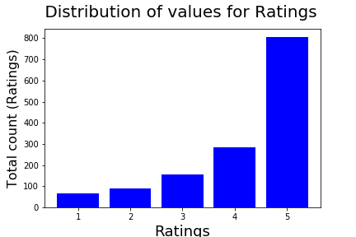
What are some insights for the “Rating” column
The Rating column is the only one with numerical values.
The Ratings column has five discrete values from 1 to 5.
We have a heavily skewed dataset that is leaning towards a 5 star rating
Conclusion:
As expected, we have a lot more positive ratings (4 or higher) than negative ones. I am happy to see that I was able to get some negative ratings as well.

Slide 6
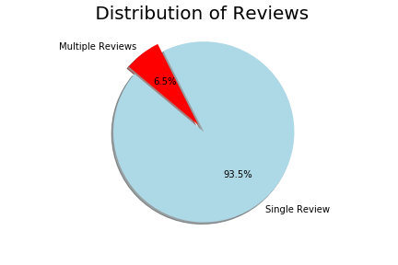
What are some insights for the “ItemID” column
The Item ID column has alphanumerical values.
At least a quarter of the reviews
We have a heavily skewed dataset that is leaning towards a single review per item
This subset only represents .7% of the original 200K dataset.
Conclusion:
I expect to see a much bigger proportion of “Multiple Reviews” per Item if I expand my subset.

Slide 7
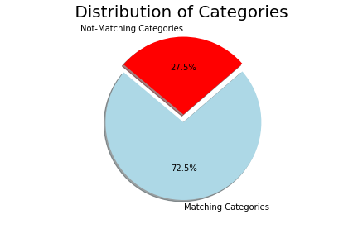
What are some insights for the “Categories” column
The “Categories” column initially had raw strings that needed to be transformed
70% of items have “Matching Categories” with pre-processed string data
Conclusion:
I believe that the original 200K dataset is made up of reviews of items of a single category rather than a representation of all types of products.

Slide 8
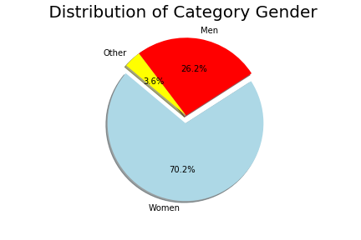
What are some insights for the “Categories” column
This dataset has more clothing targeting Women than it does Men
This dataset has 50 reviews for items not categorized for either gender.
We’ve identified 983 products categorized for women, 367 products categorized as men and 2 reviews categorized for both (These are already accounted for in the previous numbers)
The 5 star ratings remain relatively stable between both genders. This stability is lessened in the 3 and 4 star ratings.
Conclusion:
It would be interesting to compare and contrast the expectations and ratings for products targeting women vs men.

Slide 9
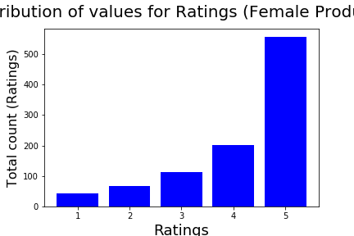
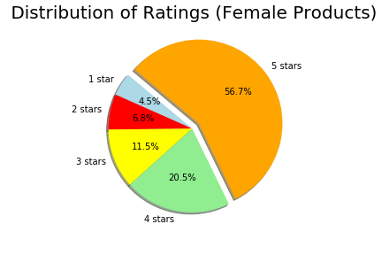
How do the ratings for female products compare vs male products?

Slide 10
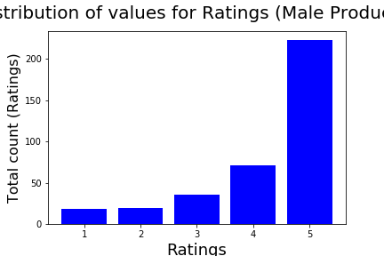
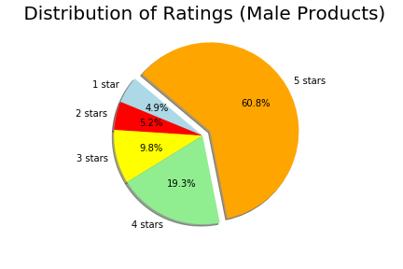
How do the ratings for female products compare vs male products?

Slide 11
Thank You!
Team: myCreativeName

